Slide 1

E-Cart Shopping
Presented by
K.Anusha
M.Jahnavi
K.Mythili
M.Usha sri

Slide 2
Agenda
Introduction
Domains
Objective and Scope
Modules Implemented
Architecture Diagram
Functionalities
DB Connectivity
Major code Snippets
Output screens
Conclusion

Slide 3
INTRODUCTION
The E-Cart Shopping System is a Python-based console application integrated with a MySQL database. It allows users to browse items, place and manage orders, and enables admin users to control inventory and view orders. The project showcases modular coding, real-time data handling, and basic authentication, providing a strong foundation for developing full-scale e-commerce applications.

Slide 4
Domains (Environment)
Programming Language: Python
IDE: Visual Studio Code
Database: MySQL
Connector: MySQL-connector-python
Architecture: Modular functions, clear separation of concerns
Database Tables: items, orders

Slide 5
Objective and Scope
To develop a simple and secure E-Cart shopping system.
Users can browse products, place orders, and manage their cart.
Admin can add, update, or remove items and view/manage orders.
This project provides an end-to-end workflow using CLI and database interaction.
Easily extendable into a GUI or web-based version.

Slide 6
Modules Implemented
Authentication Module
Login system for Admin and User
Product Management (Admin)
Add, update, delete items in the catalog
Order Management (Admin)
Accept or delete user orders
Shopping Module (User)
View available items
Place and remove orders
Database Layer
All data operations via MySQL

Slide 7
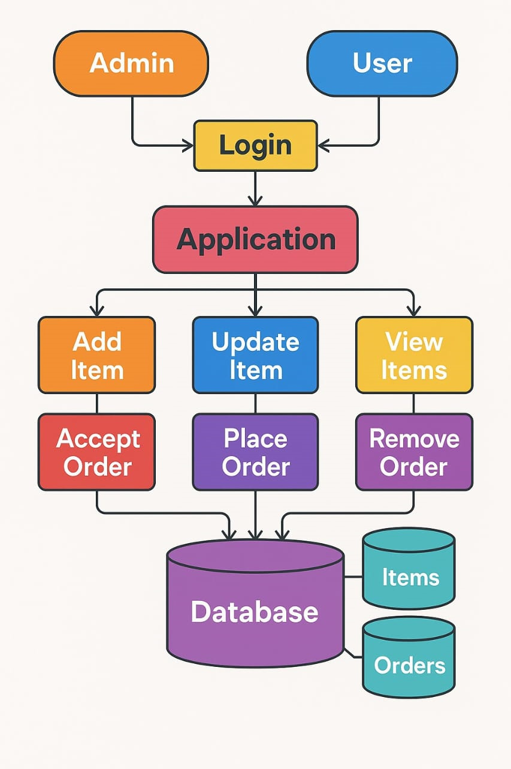
Architecture Diagram

Slide 8
Functionalities
Admin Access:
Add, update, or delete products
View and accept user orders
Maintain real-time stock
User Access:
View products
Place and remove orders
Automatic quantity management

Slide 9
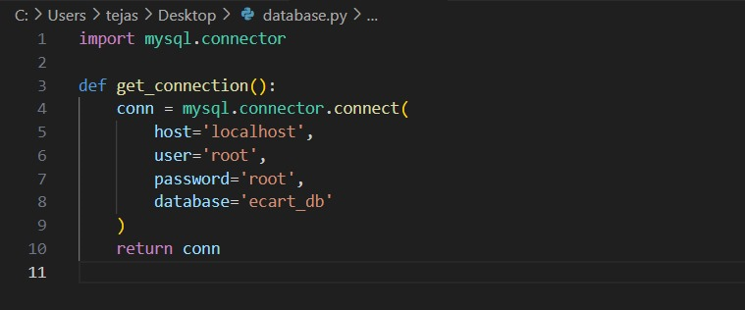
DB Connectivity
Handles persistent data access.
Connection settings are encapsulated.

Slide 10
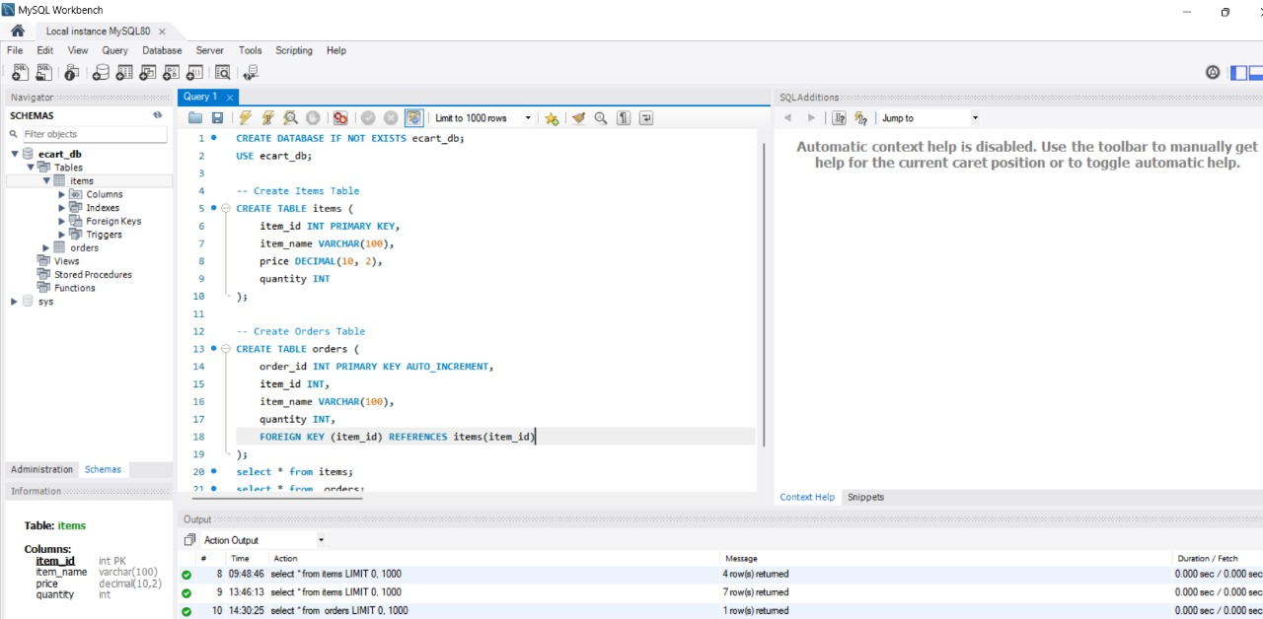
MySQL Database:

Slide 11
Major code Snippets
Placing an order(user)
Adding Items(Admin)
Updating Items(Admin)
Removing Items(Admin)
Viewing Items(User , Admin)

Slide 12
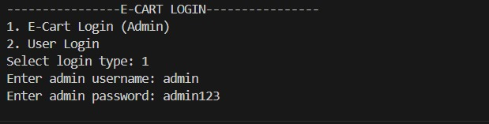
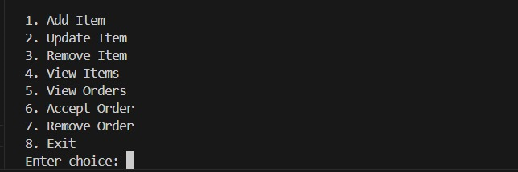
Output Screens
Admin Login

Slide 13
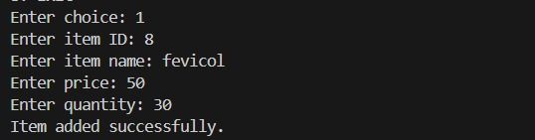
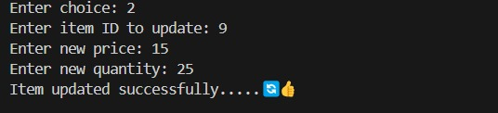

Slide 14

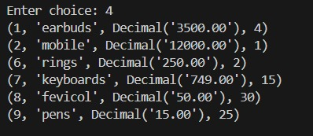

Slide 15

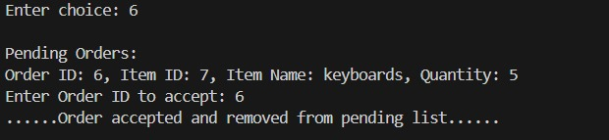


Slide 16
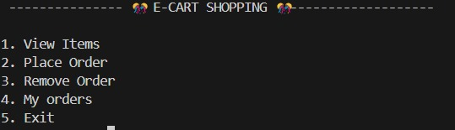
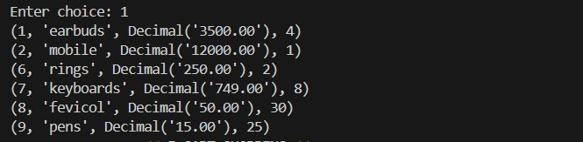
User login:

Slide 17
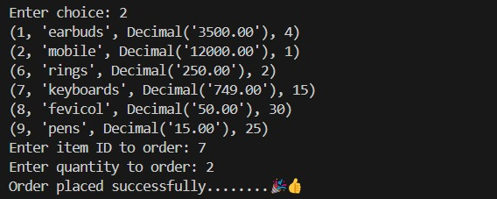



Slide 18
Conclusion
Developed a fully functional E-Cart Shopping System using Python and MySQL.
Implemented Admin/User login, item management, and order processing.
Used modular Python code to handle real-time database operations.
Applied key concepts like role-based access, SQL CRUD operations, and inventory logic.
Final system simulates an online shopping experience via a command-line interface.

Slide 19



